Slide 1
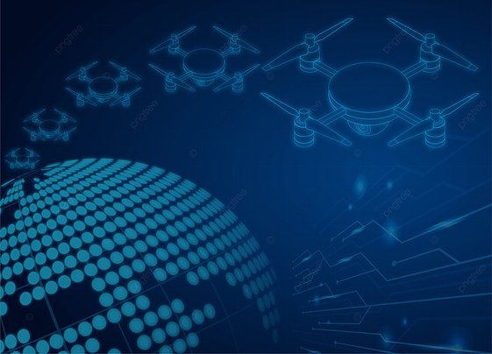
DEFENCE DRONE
ASSIGNMENT FOR
SABYASACHI B
By Group 4:
Harish H K
Supriya M K
Gaurav P
GUIDED BY
MOHAMMAD TAHIR MIRJI
L2 KTC Hubli

Slide 2
What drone means
Drone usually refers to any unpiloted aircraft. Sometimes referred to as unmanned aerial vehicles (UAVs), these crafts can carry out an impressive range of tasks, ranging from military operations to package delivery. Drones can be as large as an aircraft or as small as the palm of your hand

Slide 3
How drones works
The vertical force acting on the drone is called lift. This force is due to pressure differences across the drone (in the vertical direction). Hence, the speed, size, and shape of the propeller blade decide the amount of lift force. Lift is essential to lift the body against the gravity.

Slide 4
Types of drones
Single-Rotor Helicopter Drones
Multi-Rotor Drones
Fixed-Wing Drones
Fixed-Wing Hybrid VTOL Drones

Slide 5
DEFENCE DRONE
Unmanned aerial vehicles (UAVs) or commonly known as “drones”, are remotely controlled devices used in many industries, like Defense ,Military Warfare and in many other. They are popular in public and private sectors because of their utility and growing affordability.
The aerospace and defense industry initially made drones for counterinsurgency and defense, which have proven helpful in these environments.
Today, drones primarily serve the military industry around the world. They help for a wide range of purposes, from target decoys to research and development. Additionally, they can be equipped with software to increase accuracy and reduce casualties.

Slide 6
What are the Types of Military Drones?
Drones’ success in different operations makes them an invaluable asset. Aside from being a crucial part of militaries, they can deploy different types of drones for specific missions. There are a few different types of drones used in militaries around the world:
Fixed-wing– The fixed-wing drone is the fastest military UAV currently deployed worldwide. These drones are designed to take off and land like aeroplanes, using wings instead of rotors for lift.

Slide 7
What are the Types of Military Drones?
Single-rotor– Single-rotor drones look similar to helicopters and are more durable than other drones. While they can be more efficient than different types of drones, they require more maintenance.
Multirotor–Multirotor drones are the most straightforward option that provides the best control over positioning and framing. Because of this, they are the best choice for surveillance and reconnaissance.

Slide 8
How are Drones Changing Military Warfare?
Drones have improved military capabilities around the world in many ways. It will also continue to change military warfare through the following:

Slide 9
1. Better Reconnaissance, Surveillance, and Target Acquisition (RSTA)
Drones provide real-time information on targets’ positions, terrain, and enemy movements to commanders on the ground. Compared to high-altitude aircraft, drones can take closer footage without compromising the quality of both photos and video.
2. Reduced Cost
Drones are cheaper than conventional aircraft in terms of both price and maintenance. Because drones are unmanned, they also reduce the risk of pilots being injured mid-flight.

Slide 10
3. Increased Convenience
Compared to conventional aircraft, drones are faster and easier to deploy. They are easier to operate and don’t need training as extensive as most aircraft. Also, many drones don’t need a runway, and other types can easily fit in a backpack.
4. Increased Safety
Drone operators can provide real-time information without putting themselves at risk. On top of this, that same information also informs commanders where to position their troops to ensure safety.

Slide 11
DEFENSE DRONE MECHANISM
A defense drone typically works by using a combination of advanced technologies such as sensors, cameras, communication systems, and artificial intelligence to perform a variety of tasks. The exact mechanism of a defense drone can vary depending on its specific purpose and design, but generally, it operates using the following components and processes:
Sensors: Defense drones use a variety of sensors to detect and monitor their environment. These sensors can include radar, LIDAR, infrared, and other types of sensors that allow the drone to detect and track objects and obstacles in its vicinity.

Slide 12
DEFENSE DRONE MECHANISM
Cameras: Drones also use cameras to provide visual information to the operator or the onboard artificial intelligence system. These cameras can include both visible light and infrared cameras, which can provide different types of information depending on the application.
Communication systems: Defense drones typically use sophisticated communication systems to receive commands from operators or other systems and transmit information back to them. These systems can include satellite communication, radio frequency communication, and other types of wireless communication technologies.

Slide 13
DEFENSE DRONE MECHANISM
Artificial intelligence: Many defense drones use advanced artificial intelligence algorithms to make decisions and perform tasks autonomously. These algorithms can analyze data from sensors and cameras to identify potential threats, track targets, and make decisions about how to respond to different situations.
Propulsion: Finally, defense drones use various types of propulsion systems, including electric motors, jet engines, and other types of propulsion systems, to move through the air and perform their missions.

Slide 14
CONCLUSION
We have plentiful evidence that drones are a useful - and increasingly widely used - technology for collecting spatial and operational data in support of humanitarian operations. The IFRC should seek to support National Societies as they integrate drones into their day-to-day operations

